Slide 1


Topic : Improving open source software security using Fuzzing Domain : Cyber Security Team ID : T058 Team name :Code crusher Team members : Ch Sri Nivas Reddy(2303A51490) K Abhinay(2303A51899) K Vamshi(2303A51643) A Vignesh(2303A51640) V Nithin(2303A51652)

Slide 2

Objective
Purpose: Strengthen the security of Sumatra PDF Reader (version 3.5.2 or later) using fuzzing techniques.
Goals:- Develop a fuzzing harness to test software stability.- Identify vulnerabilities and analyze crash inputs.- Achieve extensive code coverage with tools like WinAFL.
Outcome: Deliver a working harness and a detailed technical report.

Slide 3
Problem Statement
Problem: Open-source software like Sumatra PDF Reader faces security risks from untested edge cases.
Challenges:- Limited tools for identifying critical vulnerabilities.- Insufficient code coverage during automated testing.
Pain Points:- Risk of crashes and security threats.- Need for better stability and reliability.

Slide 4
Existing system
Current System: Sumatra PDF Reader uses basic testing methods.
Limitations: Misses hidden vulnerabilities and edge cases.
Inefficiency: Low code coverage during automated testing.
Need: Advanced tools like fuzzing to enhance security.
Goal: Achieve stability and protect users from threats.

Slide 5
Proposed system
New System: A fuzzing-based security testing framework for Sumatra PDF Reader
Advantages: Detects hidden vulnerabilities and enhances stability.
Key Features: Automated testing with WinAFL and crash analysis.
Efficiency: Saves time and improves code coverage.
Goal: Strengthen security and ensure reliable software performance.

Slide 6
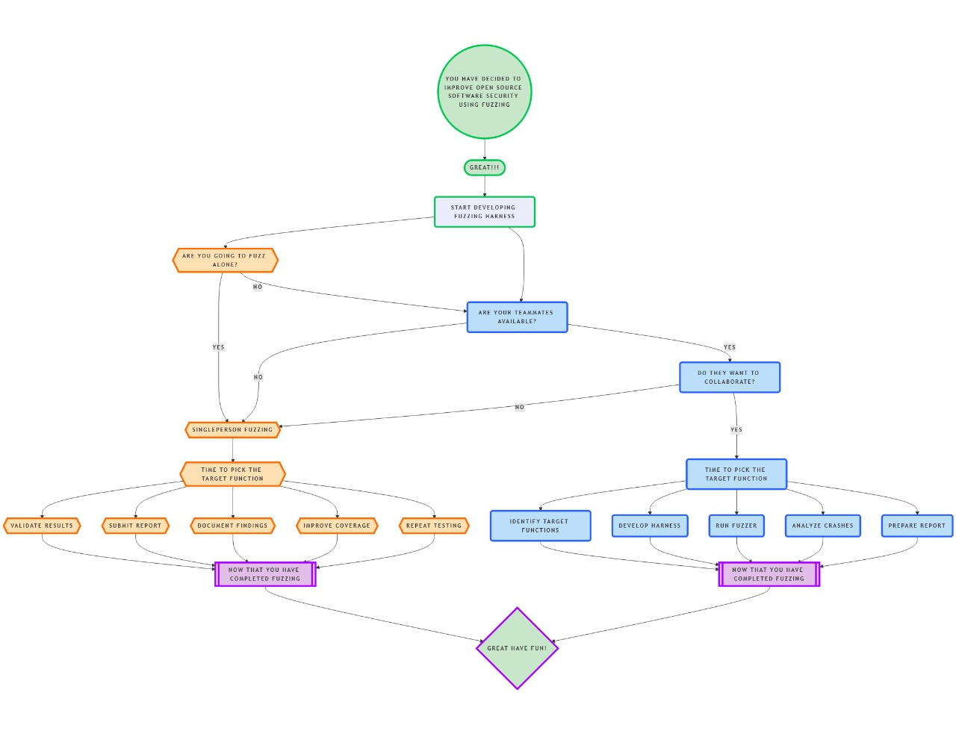
Work flow

Slide 7
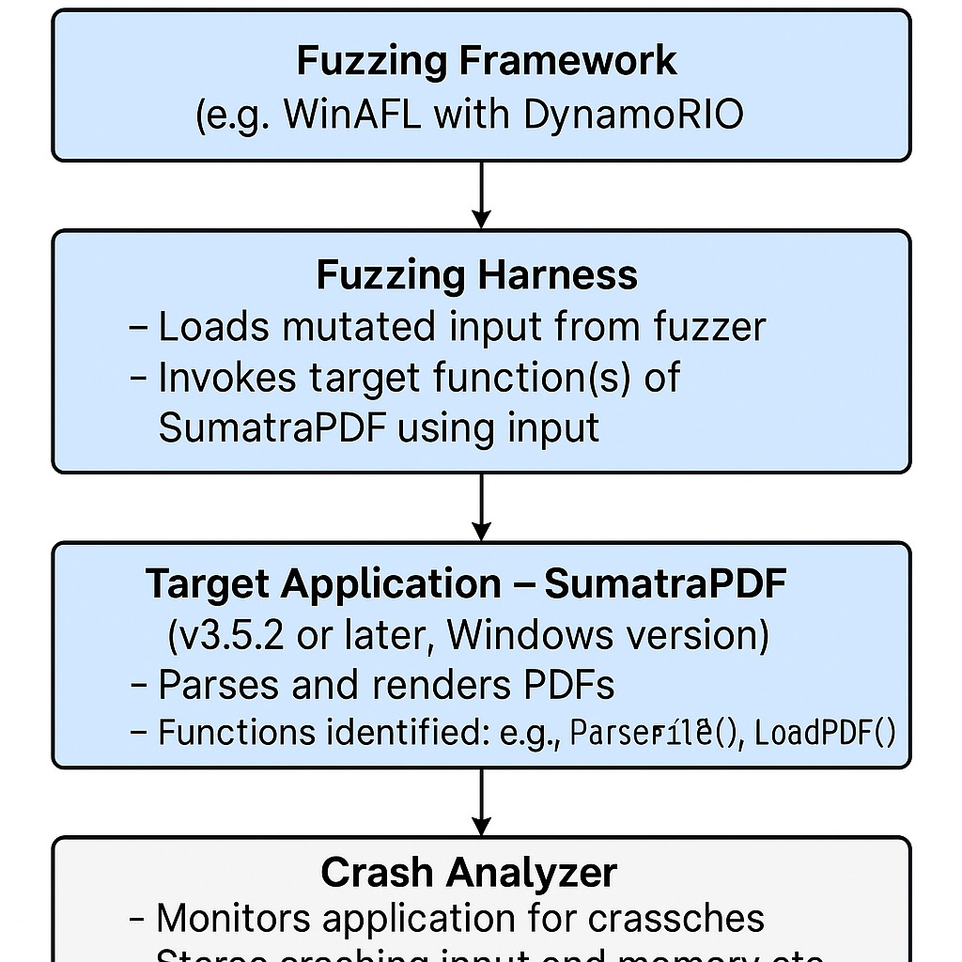

System Architecture
Tech Stack
Languages used (C)
Data base used for storage
Database security measures
Cloud service used for hosting
API’s used
Diagram analysis of final Output

Slide 8
Conclusion & Future Scope
Fuzzing helps detect vulnerabilities by testing software with unexpected inputs.
The project focused on enhancing Sumatra PDF Reader's security using WinAFL
A harness was developed to target key functions for testing.
Results were stored securely in a database and analyzed.
Improvements include broader coverage, automation, and real-time monitoring.
The project contributes to safer, more reliable software for the open-source community.

